Slide 1
ChIP-seq technology and applications
D. Puthier, C. Rioualen, J. van Helden
A compilation of slides recycled from the workshop on NGS organized in Cuernavaca in 2017

Slide 2
ChIP-seq technology

Slide 3
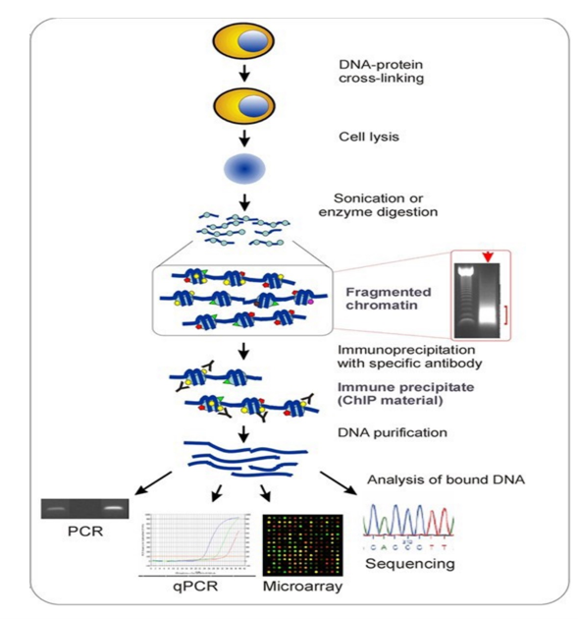
ChIP-Seq principle
Used to analyze, at the level of whole genomes:
transcription factor binding locations
histone modifications

Slide 4
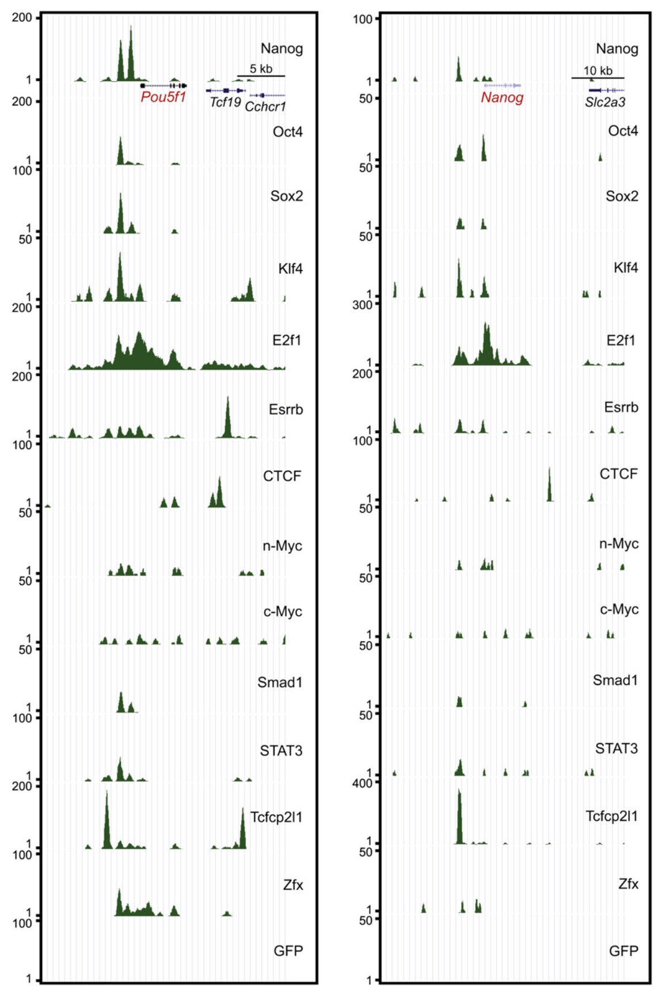
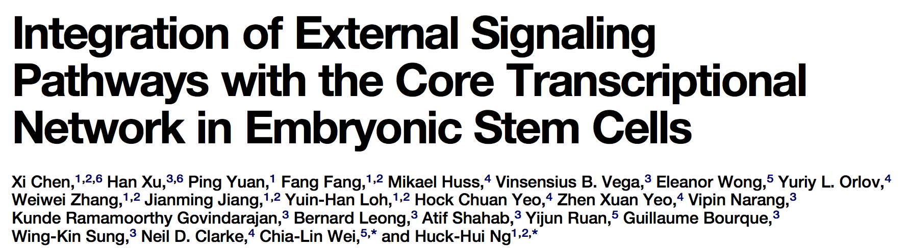
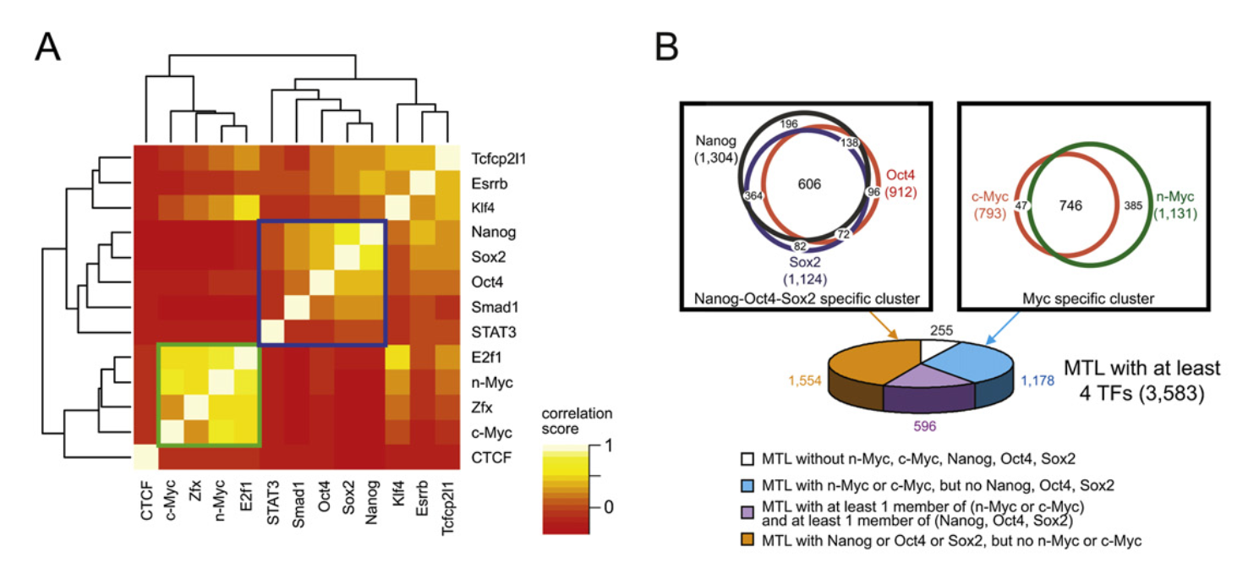
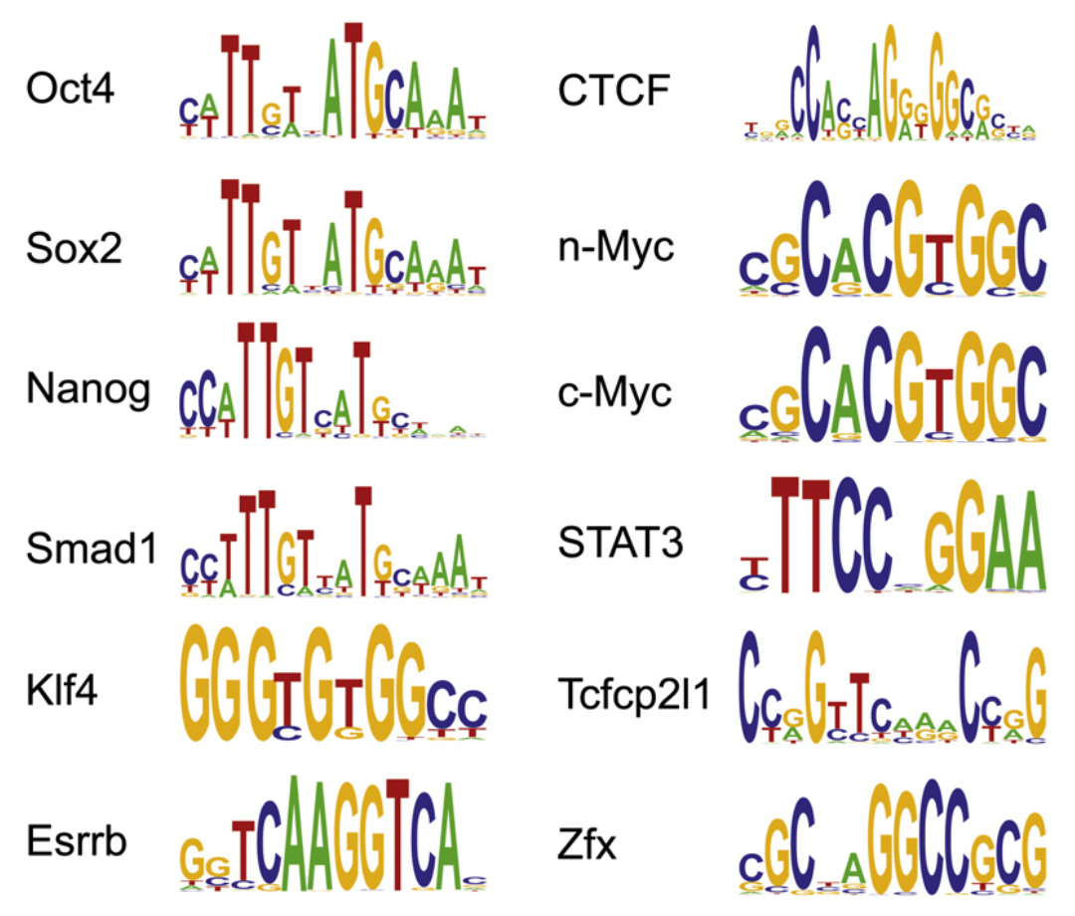
ChIP-seq for 13 TFs in mouse ES cells

Slide 5
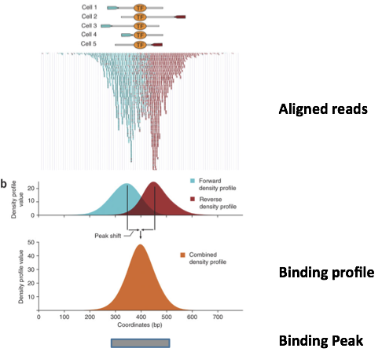
ChIP-Seq analysis in brief
Fragments (typically ~300bp) cover the region of interest + some pieces on both side.
We only sequence a short read on one or both extremities
The binding site is thus generally not in our reads !
Solutions
Bioinfo read extension
Bioinfo: read shifting
Experiment: Exo-ChIP (digest flanks between sequencing).

Slide 6
Identifying peaks from ChIP-seq reads

Slide 7
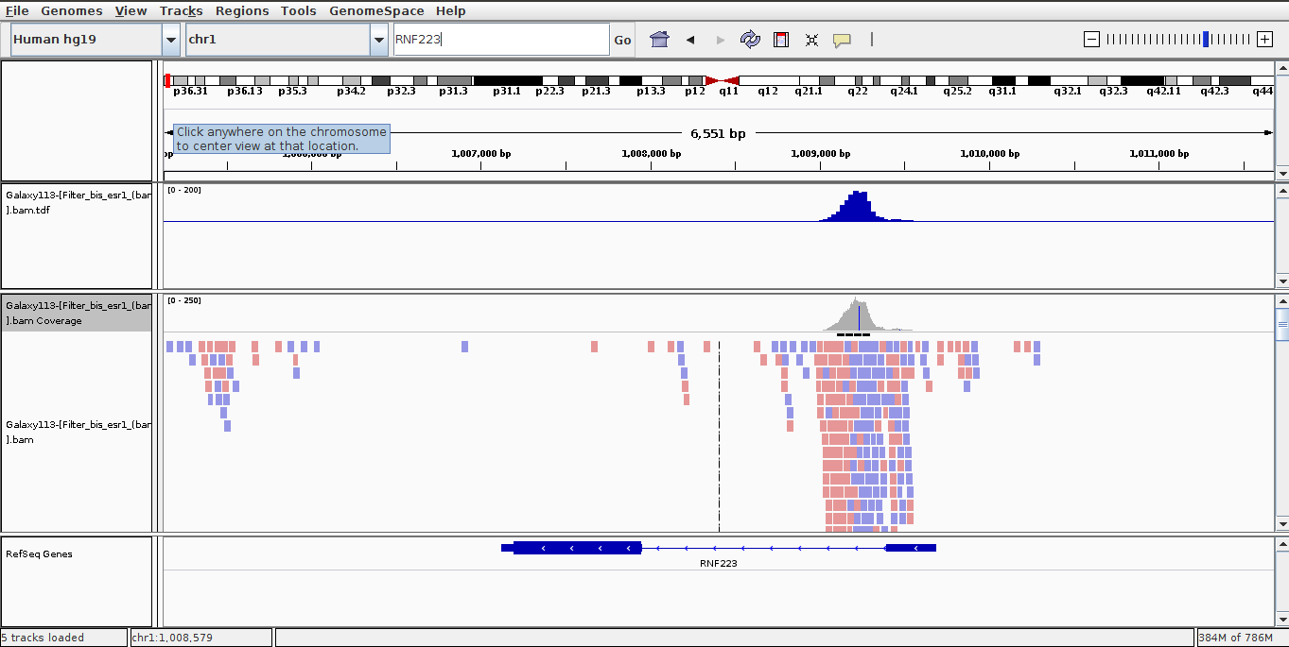
Example of read mapping

Slide 8
Coverage file and read extension
BAM files do not contain fragment location but read location
We need to extend reads to compute fragments coordinates before coverage analysis
Not required for PE
Window
w_{i}
w_{i+1}
w_{i+2}
w_{i+3}
w_{i+4}
Coverage
6
15
20
14
5

Slide 9
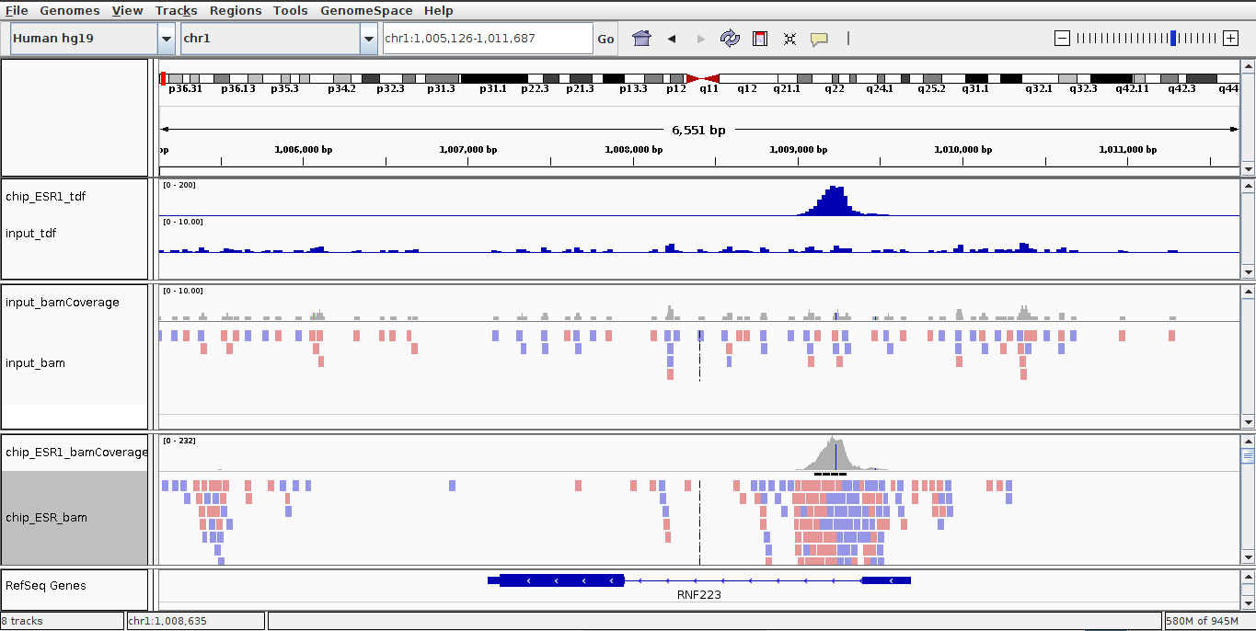
Comparison between the input and the chip samples

Slide 10
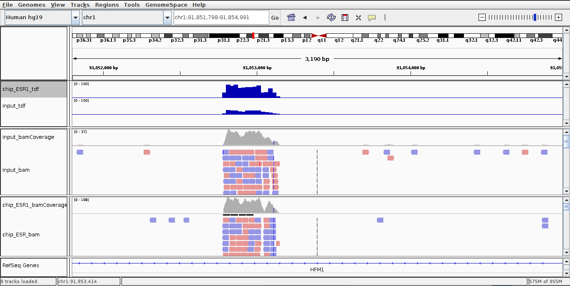
Why we use an input...

Slide 11
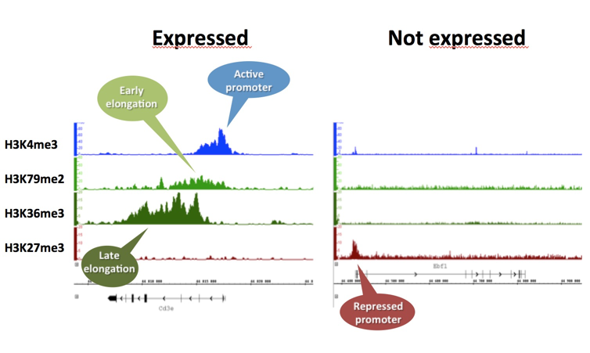
Epigenetic modifications of histones

Slide 12
Discovering motifs in the peaks

Slide 13
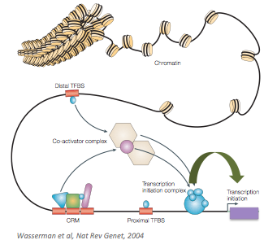
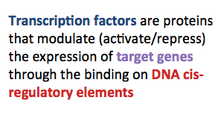
Biological concepts of transcriptional regulation

Slide 14
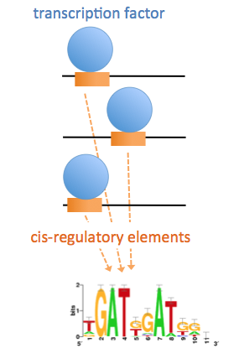
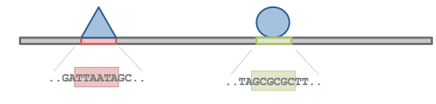
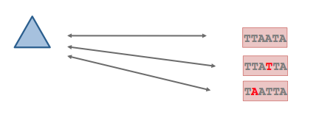
Transcription factor specificity

Slide 15
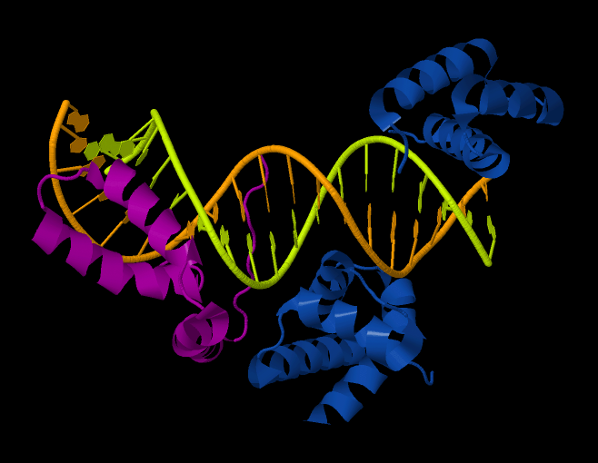
Sox2/Oct4 cooperative binding
The Sox2 and Oct4 transcription factors recognize specific DNA motifs.
Cooperative binding: Sox2 and Oct4 closely interact to bind DNA.
The pair of transcription factors recognizes a composite motif called the « SOCT » motif (SOx+OCT).
Oct1 POU domain
Sox2
Oct1 domain
http://www.pdb.org/pdb/explore/explore.do?structureId=1O4X

Slide 16
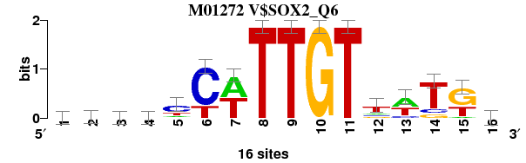
Sox2 : from binding sites to binding motif
Collection of binding sites used to build the Sox2 matrix (TRANSFAC M01272 )
R15133 GCCCTCATTGTTATGC
R15201 AAACTCTTTGTTTGGA
R15231 TTCACCATTGTTCTAG
R15267 GACTCTATTGTCTCTG
R16367 GATATCTTTGTTTCTT
R17099 TGCACCTTTGTTATGC
R19276 AATTCCATTGTTATGA
R19367 AAACTCTTTGTTTGGA
R19510 ATGGACATTGTAATGC
R22342 AGGCCTTTTGTCCTGG
R22344 TGTGCTTTTGTNNNNN
R22359 CTCAACTTTGTAATTT
R22961 GCAGCCATTGTGATGC
R23679 CACCCCTTTGTTATGC
R25928 TTTTCTATTGTTTTTA
R27428 AAAGGCATTGTGTTTC
Position-specific scoring matrix (PSSM)
A | 6 | 7 | 4 | 4 | 2 | 0 | 8 | 0 | 0 | 0 | 0 | 2 | 7 | 0 | 1 | 4
C | 2 | 2 | 6 | 5 | 9 | 12 | 0 | 0 | 0 | 0 | 0 | 2 | 2 | 2 | 0 | 6
G | 4 | 3 | 2 | 4 | 1 | 0 | 0 | 0 | 0 | 16 | 0 | 2 | 0 | 2 | 9 | 3
T | 4 | 4 | 4 | 3 | 4 | 4 | 8 | 16 | 16 | 0 | 16 | 9 | 6 | 11 | 5 | 2
Sequence logo

Slide 17
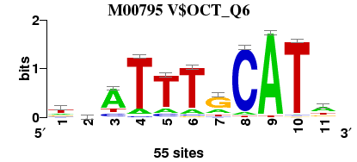
“Family” binding motifs (FBM)
In addition to TF-specific matrices, TRANSFAC contains matrices representing the “consensus” of the binding specificity for several transcription factors belonging to the OCT family.
This matrix was built from 55 sites, collected from different organisms (mouse, human, cat, xenopus, ...).
Collection of binding sites used to build the motif of the OCT family (TRANSFAC M00795)
R00306 TAATTAGCATA
R00551 ATATTTGCATT
R00662 TTATTTGCATA
R00664 TCATTTGCATA
R00666 ACATTTGCATA
R00814 TCGTTAGCATG
R00815 CGCATGGCATC
R00820 GGAATTCCATT
R00824 CGTATCTCATT
R00834 TTATTTGCATA
R00842 GGATTTGCATA
R00855 GTATTTGCATA
R00872 TAATTTGCATT
R00888 CGATTTGCATA
R00893 TGATTTGCATA
... 40 other sites
Position-specific scoring matrix (PSSM)
A | 10 | 14 | 37 | 6 | 7 | 6 | 11 | 3 | 53 | 1 | 27
C | 7 | 12 | 7 | 2 | 5 | 2 | 3 | 50 | 0 | 1 | 4
G | 10 | 15 | 2 | 0 | 1 | 2 | 34 | 0 | 0 | 1 | 10
T | 28 | 14 | 9 | 47 | 42 | 45 | 7 | 2 | 2 | 52 | 14
Sequence logo

Slide 18
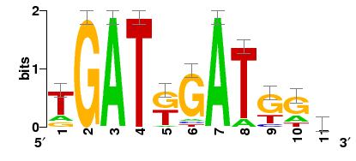
De novo motif discovery
Case 1: promoters of co-expressed genes
Case 2: ChIP-seq peaks
cis-regulatory
elements
TF binding site
gene 1
gene 2
gene 3
discovered motif (represented as a sequence logo)

Slide 19
De novo motif discovery
Find exceptional motifs based on the sequence only
(No prior knowledge of the motif to look for)
Criteria of exceptionality:
Over-/under-representation: higher/lower frequency than expected by chance
Position bias: concentration at specific positions relative to some reference coordinates (e.g. TSS, peak center, …).

Slide 20
Some motif discovery tools
MEME (Bailey et al., 1994)
RSAT oligo-analysis (van Helden et al., 1998)
AlignACE (Roth et al. 1998)
RSAT position-analysis (van Helden et al., 2000)
Weeder (Pavesi et al. 2001)
MotifSampler (Thijs et al., 2001)
… many others

Slide 21
Motif analysis on ChIP-seq peaks
Motif discovery from peak sequences, without a priori ("de novo" analysis).
Check if the expected motif (ChIP-ped factor) can be discovered from the peaks.
If not, evaluate if the experiment and bioinformatics treatment was OK (e.g. functional enrichment).
Improve annotated motifs
Obtain a well-documented motifs (built from thousands of sites), supposedly more reliable than "classical" motifs build from individual experiments (e.g. 10 sites from footprints and EMSA).
Main annotation path for recent motif database releases (JASPAR, TRANSFAC, …).
Discover partner transcription factors.
Differential motif discovery
Discover differentially represented motifs between a peak set of interest (test) compared to another one (control).
Peak scanning
Goal: identify binding sites within the peaks.
Typical ChIP-seq peak: ~100 to 1000bp Actual binding site: 6 to 10 bp.
Peak enrichment for known motifs
Scan sequences to identify putative binding sites for TFs known to interact.
Compare observed/expected number of sites.
Notes:
This slide might be a little dense...

Slide 22
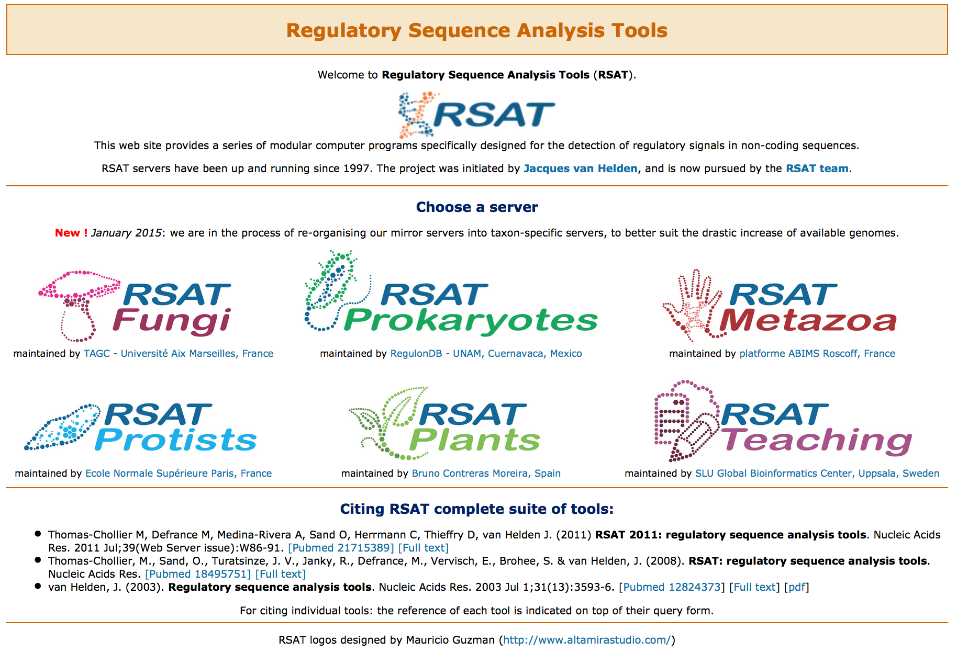
Regulatory sequence Analysis Tools (http://rsat.eu/)
170 Fungi
4648 Bacteria + 235 Archaea
70 Metazoa
20 "Protists"
39 Plants

Slide 23



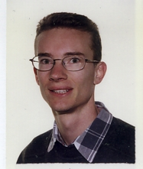
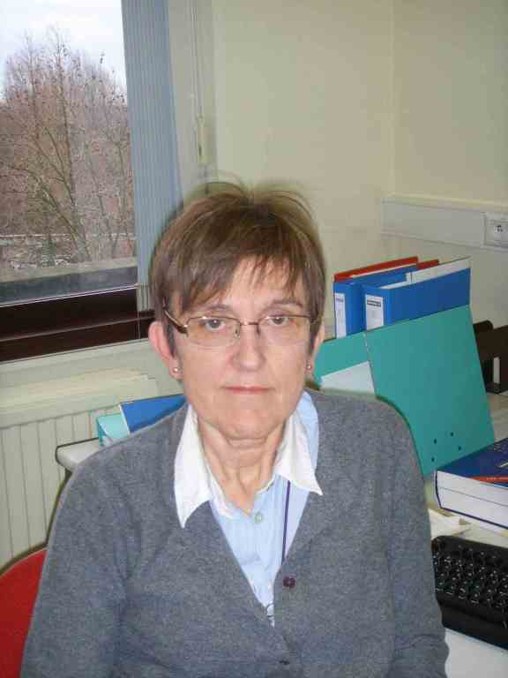
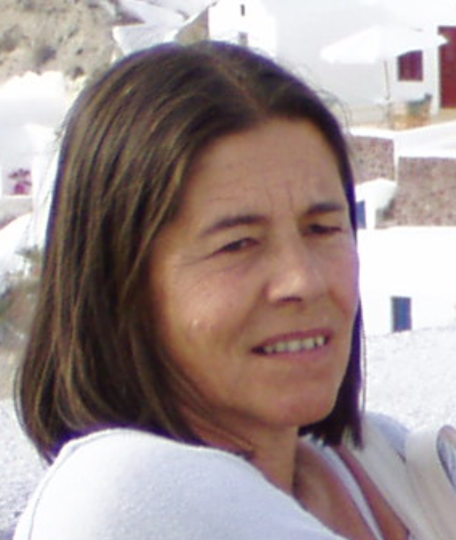
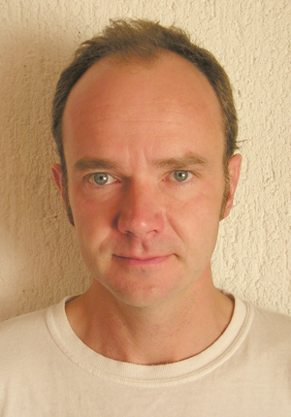

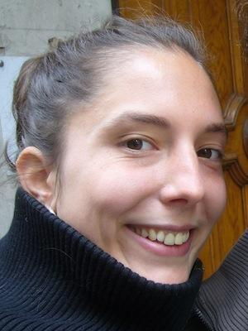
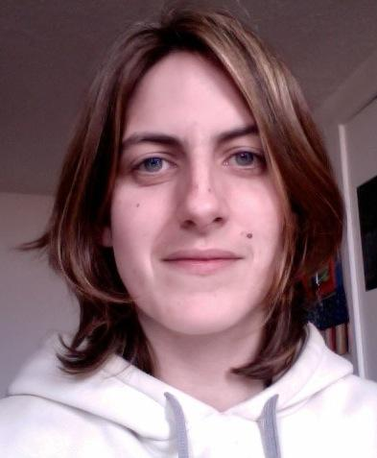

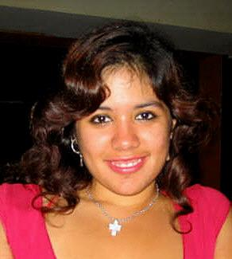
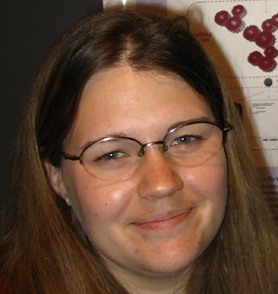


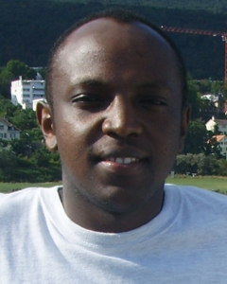





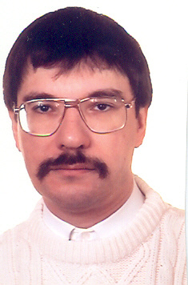
Contributors
From ULB
Sylvain Brohée
Postdoc
Nicolas Simonis
Postdoc
Didier Croes
Postddoc
Didier Gonze
Premier assistant
Myriam Loubriat
Secretary
Ariane Toussaint
Professor Emeritus
Jacques van Helden
Professor
Leon Juvenal
HajingaboE
PhD Student
Maud Vidick
PhD Student (co-direction)
Elodie Darbo
PhD Student
co-direction Marseille
Alejandra Medina
PhD Student
co-direction Mexico
Morgane Thomas-Chollier
PhD student+postdoc
Matthieu Defrance
Postdoc
Olivier Sand
Postdoc
Jean Valéry Turatsinze
PhD student

Slide 24
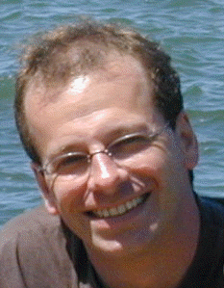
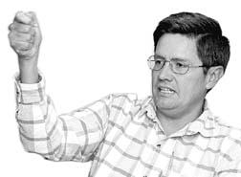
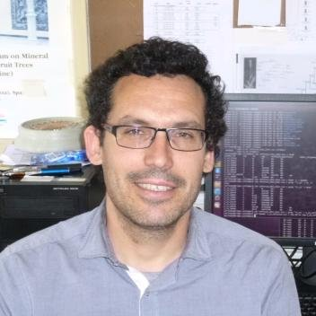


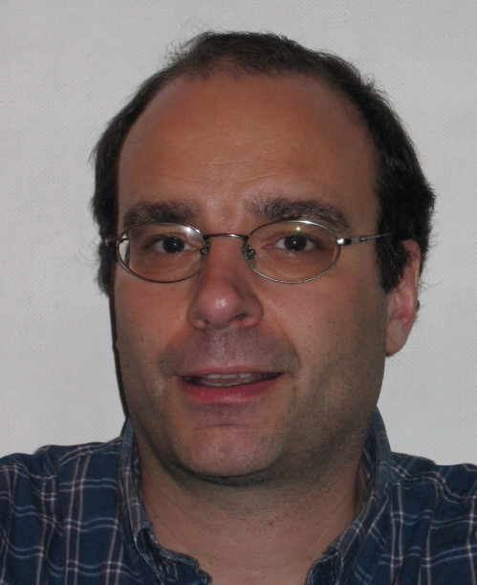

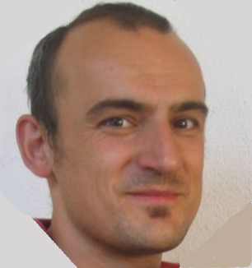
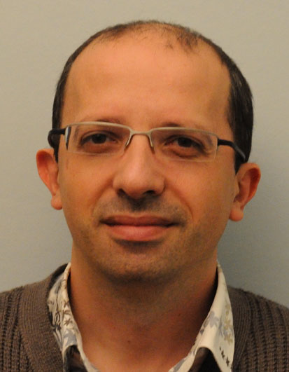
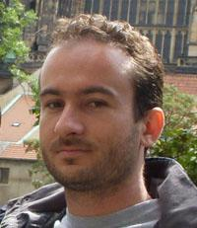
Collaborators
Bruno André (ULB, Bruxelles, Belgium)
Initiation of the RSAT project.
Conception of oligo-analysis.
Analysis of yeast regulation.
Julio Collado-Vides (CCG, Cuernavaca - Mexico)
Initiation of the RSAT project
Analysis of regulation
in bacterial genomes
Bruno Contreras
(CSIC, Saragossa, Spain)
Denis Thieffry (ENS, Paris, France)
ChIP-seq tools + regulatory networks.
Alejandra Medina-Rivera
(CCG, Cuernavaca - Mexico)
Evaluation of matrix quality.
Phylogenetic footprints in Baceria.
Jaime Castro-Mondragon (PhD at TAGC,
Marseille, France)
Carl Herrmann (TAGC, Marseille, France)
ChIP-seq analysis (peak-motifs, compare-matrices).
Lionel Spinelli (TAGC, Marseille, France)
Development of peak-footprints.
Elodie Darbo (TAGC, Marseille, France)
Analysis of co-expression clusters + ChIP-seq data (transcription factors, chromatin marks).
Cei Abreu-Goodger
(Sanger Institute, Hinxton, UK)
Evaluation of matrix quality
on bacterial regulons.

Slide 25
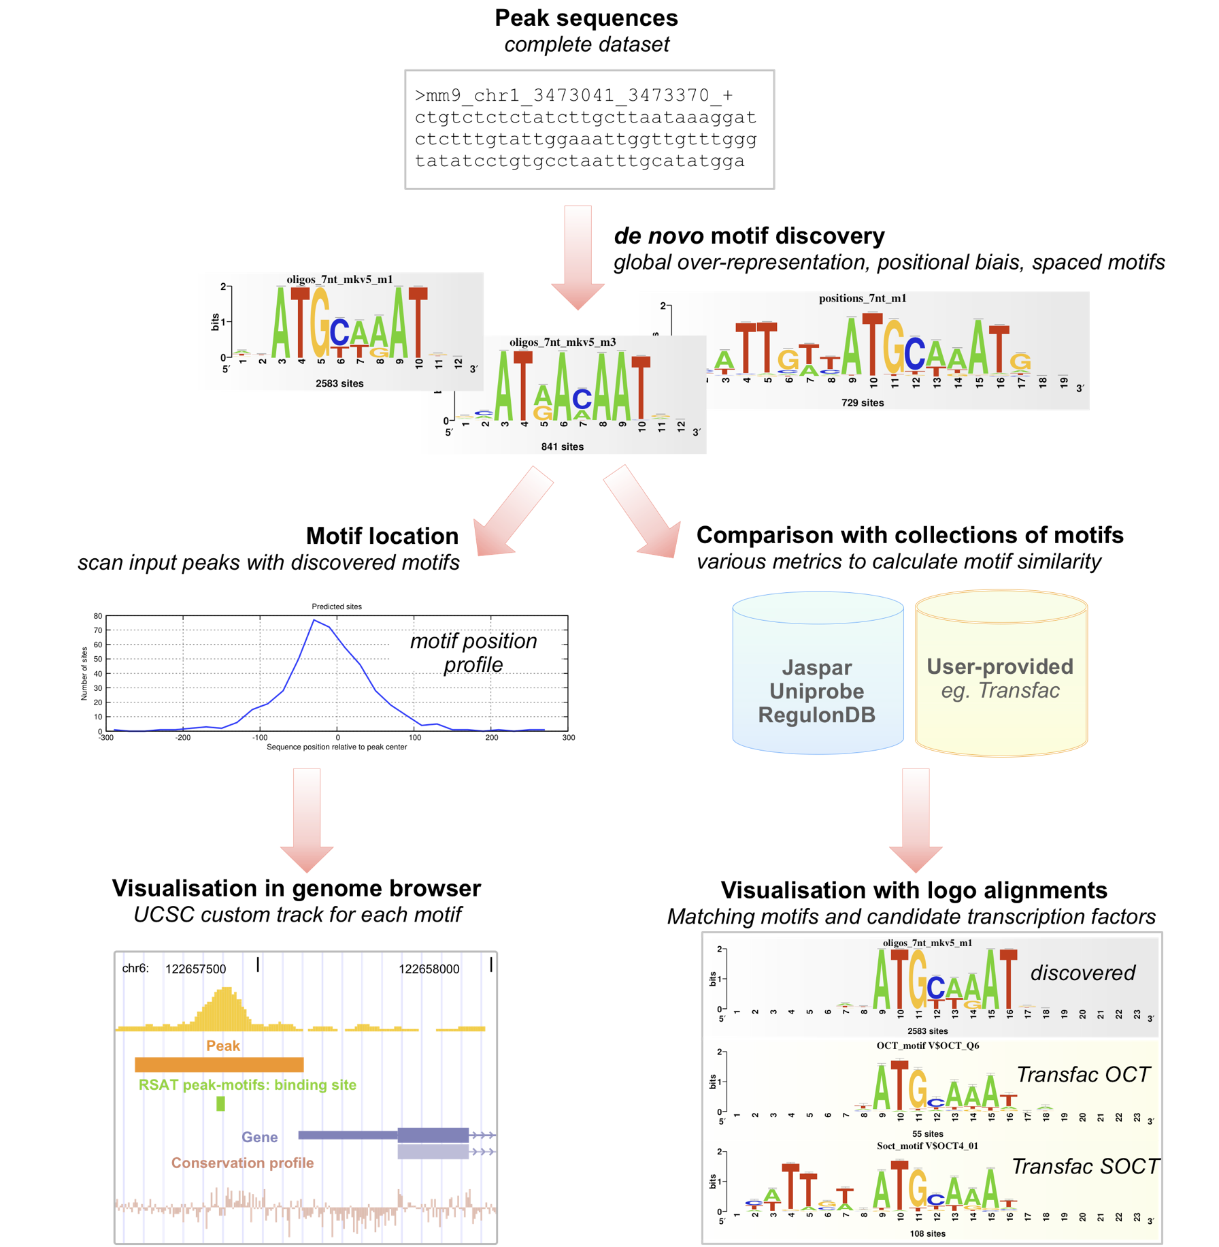
Peak-motifs
A workflow enabling to discover motifs in large sequence sets (tens of Mb) resulting from ChIP-seq experiments.
Complementary pattern discovery criteria
Global over-representation
Positional biases
Local over-representation
Links from motifs to putative binding factors
motif databases
user-specified reference motifs
Prediction of binding sites within the peaks.
Inspect distribution around peak centers
Can be loaded as UCSC track
Interfaces
Web interface
Stand-alone (Unix command-line)
Web services (SOAP/WSDL)
Virtual Machine for VirtualBox
Virtual machine at the IFB cloud
Soon: Debian package
Soon: Docker container
Thomas-Chollier M, Herrmann C, Defrance M, Sand O, Thieffry D, van Helden J. 2012. RSAT peak-motifs: motif analysis in full-size ChIP-seq datasets. Nucleic Acids Res 40(4): e31.
Thomas-Chollier,M., Darbo,E., Herrmann,C., Defrance,M., Thieffry,D. and van Helden,J. (2012). A complete workflow for the analysis of full-size ChIP-seq (and similar) data sets using peak-motifs. Nature Protocols, 7, 1551–1568.

Slide 26
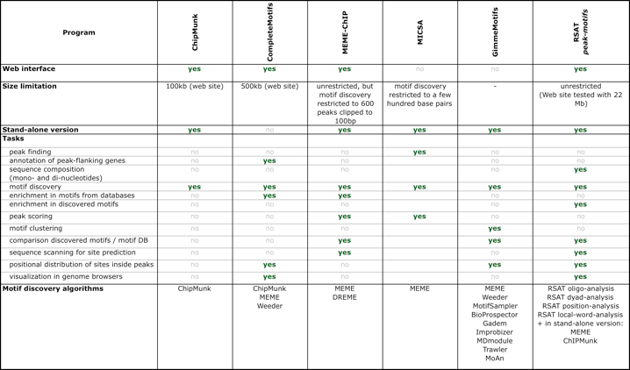
Peak-motifs: why providing yet another tool?

Slide 27
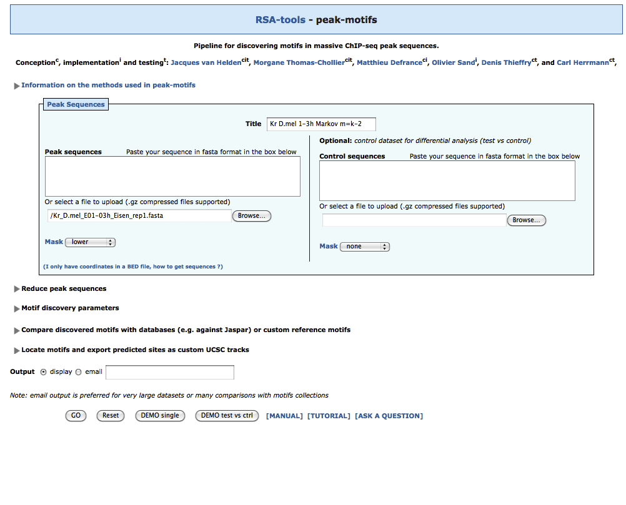
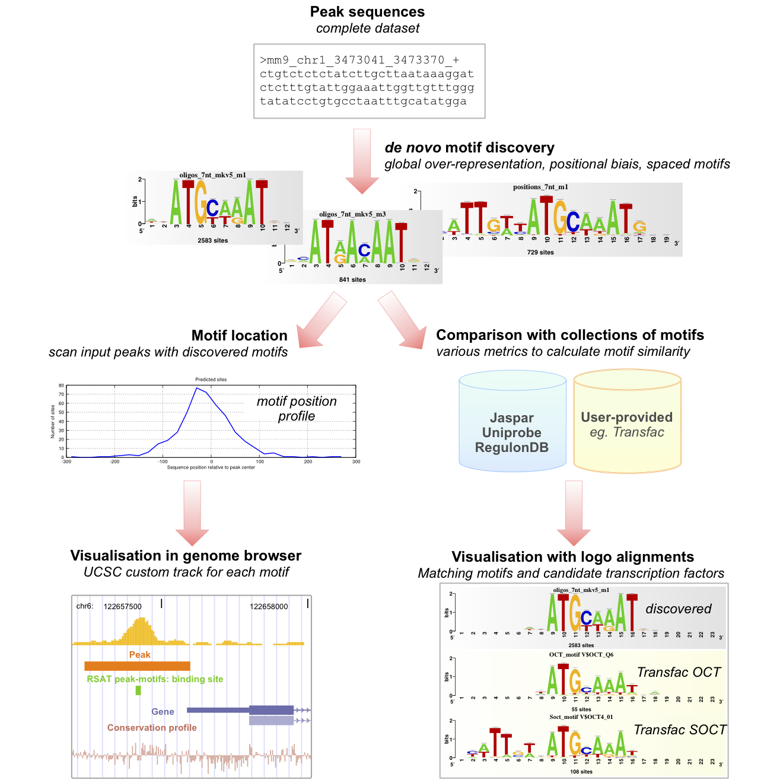
Peak-motifs: why providing yet another tool?
Fast and scalable
Treat full-size datasets
Complete pipeline
Peak properties (nucleotide, dinucleotide composition, lengths)
Motif discovery
Comparison with known motifs
Peak scanning
Accessible to non-specialists
Demo buttons
Tutorials & Protocols
Human-readable HTML report with links to all result files.
Thomas-Chollier, Herrmann, Defrance, Sand, Thieffry, van Helden Nucleic Acids Research, 2012

Slide 28
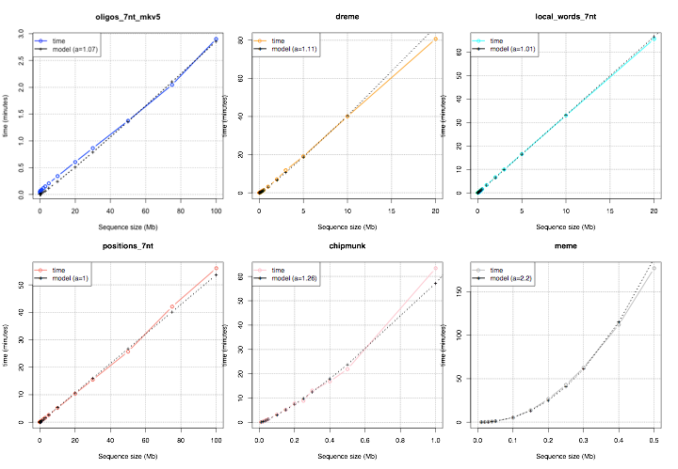
Time complexity of motif discovery algorithms
Linear
> linear
> quadratic

Slide 29
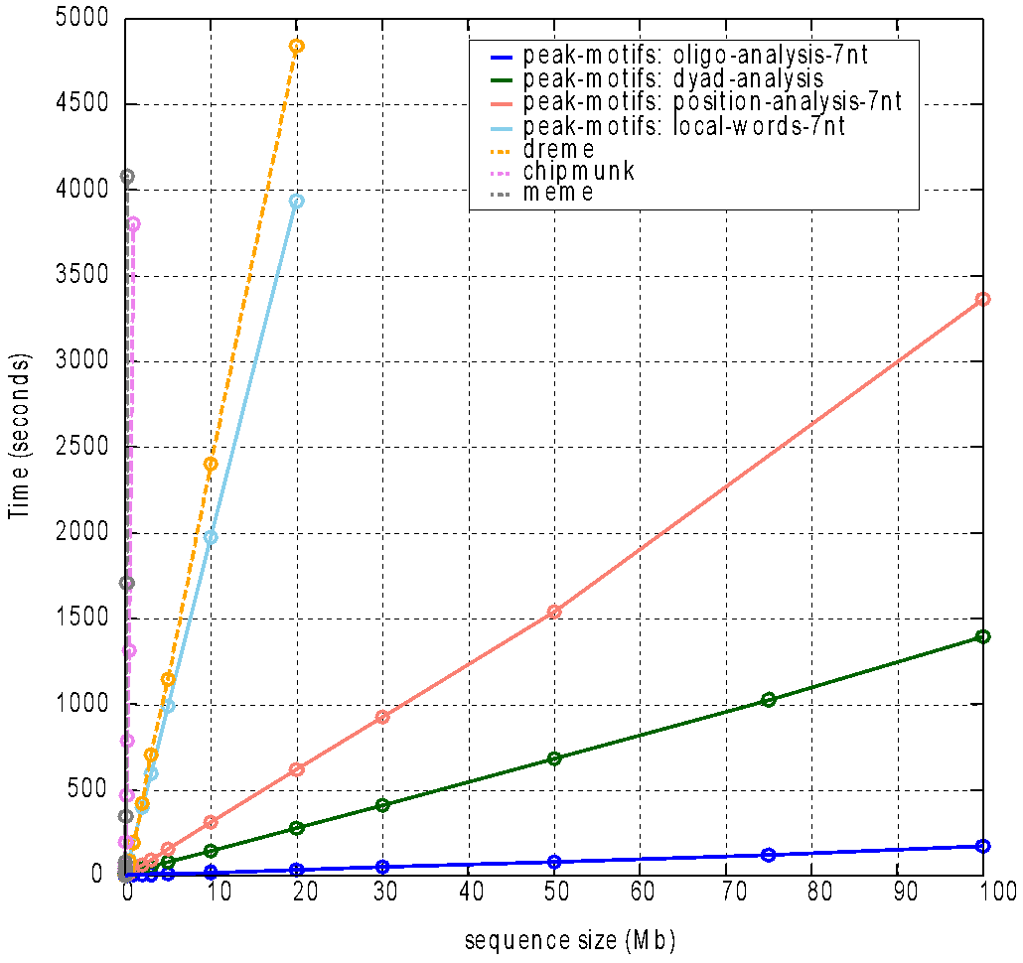
Peak-motifs: scalability
Fast and scalable
Treat full-size datasets
Using 4 complementary algorithms
Global over-representation
oligo-analysis
dyad-analysis (spaced motifs)
Positional bias
position-analysis
local-words
1h
size limit of other websites
typical ChIP-seq dataset
Thomas-Chollier, Herrmann, Defrance, Sand, Thieffry, van Helden Nucleic Acids Research, 2012

Slide 30
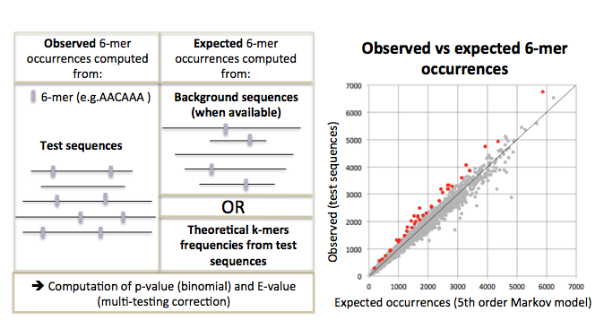
Motif discovery: k-mer over-representation

Slide 31
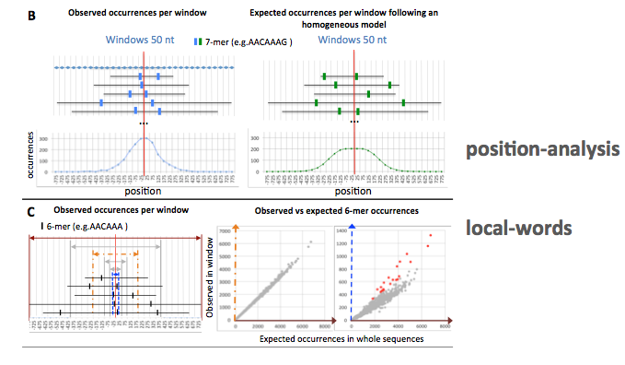
Motif discovery: k-mer position biases

Slide 32
Direct versus indirect binding
ChIP-seq does not necessarily reveal direct binding: The motif of the targeted TF is not always found in peaks!
Direct binding
Indirect binding

Slide 33
Negative Controls

Slide 34
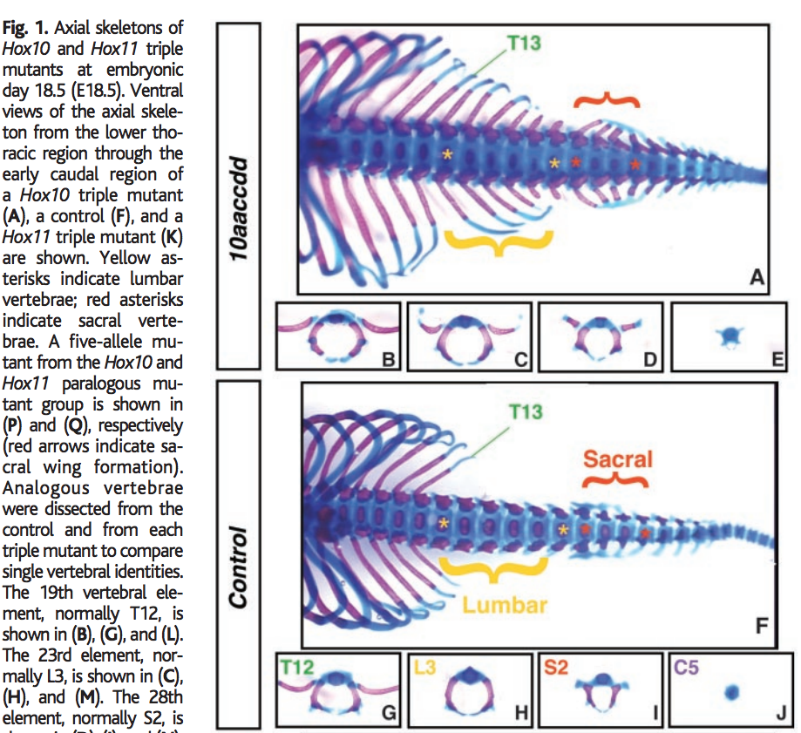
Negative Controls in biology
One example from a multitude: Wellik and Mario R Capecchi, Science, 2003.

Slide 35
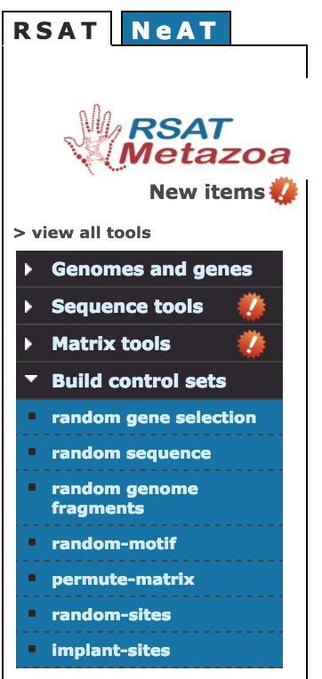
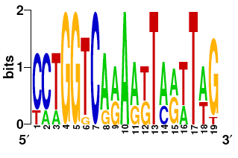
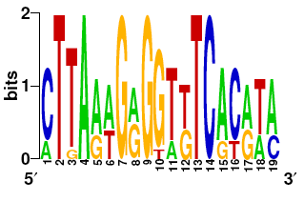
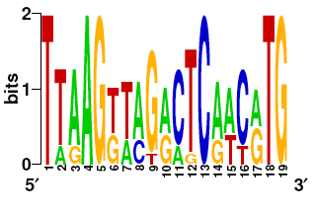

Negative and positive controls in bioinformatics
Negative control: quantify the capability of the program to return a negative answer when there are no regulatory elements.
Artificial sequences
RSAT random-sequences (Markov models to mimic k-mer frequencies of the organism )
Biological sequences without common regulation
RSAT random-genes (negative control for expression clusters)
RSAT random-genome-fragments (negative controls for ChIP-seq)
Randomized motifs: column permutations preserve nucleotide frequencies and information content
RSAT permute-matrix
Positive control: quantify the capability of the program to detect known regulatory elements
Annotated sites (e.g. sites from TRANSFAC) in their original context (promoter sequences).
Annotated sites implanted in other context
Biological sequences (random selection).
Artificial sequences.
Artificial sites implanted in artificial sequences.
RSAT random-motif
RSAT random-sites
RSAT implant-sites

Slide 36
RSAT random-genome-fragments
Select a set of fragments with random positions in a given genome, and return their coordinates and/or sequences
Adapted to chip-seq ?
Yes: same number of peaks + same size
No: composition of the sequences (nucleotides, k-mers) may change depends on genomic regions
Complexify the control
Make sure no peak is covered
Take regions close / far from the peaks
Maintain same composition
Maintain same dataset size
…

Slide 37



Why is it important ?
To prevent this ….
We show that the claimed universality of CPEs is explained by the low specificities of the patterns used and that the same match frequencies are obtained with two negative controls (randomized sequences and scrambled patterns).
Our analyses also cast doubt on the biological significance of most of the 150,753 non-messenger- RNA-associated ChIP-exo peaks, 72% of which lie within repetitive regions.

Slide 38
Supplementary information

Slide 39
To go further
The next slides explain step by step the algorithm behind oligo-analysis
Peak-motifs : follow this protocol to grasp the detailed tweaking of parameters (send us an email to have free access to the PDF if necessary)
Thomas-Chollier et al. A complete workflow for the analysis of full-size ChIP-seq (and similar) data sets using peak-motifs. Nature Protocols 7, 1551–1568 (2012).
Description and evaluation of peak-motifs
Matrix-quality : RSAT program that can be used to evaluate the enrichment of motifs in peaks
Description of the RSAT software suite
Medina-Rivera A, Abreu-Goodger C, Thomas-Chollier M, Salgado H, Collado-Vides J, van Helden J.Theoretical and empirical quality assessment of transcription factor-binding motifs.Nucleic Acids Res. 2011 Feb;39(3):808-24. doi: 10.1093/nar/gkq710. Epub 2010 Oct 4.
Tutorial for ECCB 2014 : http://rsat.ulb.ac.be/eccb14/

Slide 40
More info: RSAT descriptions + protocols
Medina-Rivera,A., Defrance,M., Sand,O., Herrmann,C., Castro-Mondragon,J.A., Delerce,J., Jaeger,S., Blanchet,C., Vincens,P., Caron,C., et al. (2015) RSAT 2015: Regulatory Sequence Analysis Tools. Nucleic Acids Res, 43, W50–6.
Thomas-Chollier,M., Darbo,E., Herrmann,C., Defrance,M., Thieffry,D. and van Helden,J. (2012) A complete workflow for the analysis of full-size ChIP-seq (and similar) data sets using peak-motifs. Nature Protocols, 7, 1551–1568.
Thomas-Chollier,M., Herrmann,C., Defrance,M., Sand,O., Thieffry,D. and van Helden,J. (2012) RSAT peak-motifs: motif analysis in full-size ChIP-seq datasets. Nucleic Acids Res, 40, e31–e31.
Thomas-Chollier,M., Defrance,M., Medina-Rivera,A., Sand,O., Herrmann,C., Thieffry,D. and van Helden,J. (2011) RSAT 2011: regulatory sequence analysis tools. Nucleic Acids Res, 39, W86–91.
Thomas-Chollier,M., Sand,O., Turatsinze,J.-V., Janky,R., Defrance,M., Vervisch,E., Brohée,S. and van Helden,J. (2008) RSAT: regulatory sequence analysis tools. Nucleic Acids Res, 36, W119–27.
Sand,O., Thomas-Chollier,M., Vervisch,E. and van Helden,J. (2008) Analyzing multiple data sets by interconnecting RSAT programs via SOAP Web services: an example with ChIP-chip data. Nature Protocols, 3, 1604–1615.
Turatsinze,J.-V., Thomas-Chollier,M., Defrance,M. and van Helden,J. (2008) Using RSAT to scan genome sequences for transcription factor binding sites and cis-regulatory modules. Nature Protocols, 3, 1578–1588.
Defrance,M., Janky,R., Sand,O. and van Helden,J. (2008) Using RSAT oligo-analysis and dyad-analysis tools to discover regulatory signals in nucleic sequences. Nature Protocols, 3, 1589–1603.

Slide 41
Principle: detect unexpected patterns
Binding sites are represented as “words” = “oligonucleotides”=“k-mer”
e.g. acgtga is a 6-mer
Signal is likely to be more frequent in the upstream regions of the co-regulated genes than in a random selection of genes
We will thus detect over-represented words (k-mers, oligonucleotides).
TF
Target gene
…HIS7
5’- TCTCTCTCCACGGCTAATTAGGTGATCATGAAAAAATGAAAAATTCATGAGAAAAGAGTCAGACATCGAAACATACAT
5’- ATGGCAGAATCACTTTAAAACGTGGCCCCACCCGCTGCACCCTGTGCATTTTGTACGTTACTGCGAAATGACTCAACG
…ARO4
5’- CACATCCAACGAATCACCTCACCGTTATCGTGACTCACTTTCTTTCGCATCGCCGAAGTGCCATAAAAAATATTTTTT
…ILV6
5’- TGCGAACAAAAGAGTCATTACAACGAGGAAATAGAAGAAAATGAAAAATTTTCGACAAAATGTATAGTCATTTCTATC
…THR4
5’- ACAAAGGTACCTTCCTGGCCAATCTCACAGATTTAATATAGTAAATTGTCATGCATATGACTCATCCCGAACATGAAA
…ARO1
5’- ATTGATTGACTCATTTTCCTCTGACTACTACCAGTTCAAAATGTTAGAGAAAAATAGAAAAGCAGAAAAAATAAATAA
…HOM2
5’- GGCGCCACAGTCCGCGTTTGGTTATCCGGCTGACTCATTCTGACTCTTTTTTGGAAAGTGTGGCATGTGCTTCACACA
…PRO3

Slide 42
Motif discovery using word counting
Idea:
motifs corresponding to binding sites are generally repeated in the dataset
→ capture this statistical signal
Algorithm
count occurrences of all k-mers in a set of related sequences (promoters of co-expressed genes, in ChIP bound regions,...)

Slide 43

Let’s take an example (yeast Saccharomyces cerevisiae)
NIT
7 genes expressed under low nitrogen conditions
MET
10 genes expressed in absence of methionine
PHO
5 genes expressed under phosphate stress
PHO
aaaaaa|tttttt 51
aaaaag|cttttt 15
aagaaa|tttctt 14
gaaaaa|tttttc 13
tgccaa|ttggca 12
aaaaat|attttt 12
aaatta|taattt 12
agaaaa|ttttct 11
caagaa|ttcttg 11
aaacgt|acgttt 11
aaagaa|ttcttt 11
acgtgc|gcacgt 10
aataat|attatt 10
aagaag|cttctt 10
atataa|ttatat 10
MET
aaaaaa|tttttt 105
atatat|atatat 41
gaaaaa|tttttc 40
tatata|tatata 40
aaaaat|attttt 35
aagaaa|tttctt 29
agaaaa|ttttct 28
aaaata|tatttt 26
aaaaag|cttttt 25
agaaat|atttct 24
aaataa|ttattt 22
taaaaa|ttttta 21
tgaaaa|ttttca 21
ataata|tattat 20
atataa|ttatat 20
NIT
aaaaaa|tttttt 80
cttatc|gataag 26
tatata|tatata 22
ataaga|tcttat 20
aagaaa|tttctt 20
gaaaaa|tttttc 19
atatat|atatat 19
agataa|ttatct 17
agaaaa|ttttct 17
aaagaa|ttcttt 16
aaaaca|tgtttt 16
aaaaag|cttttt 15
agaaga|tcttct 14
tgataa|ttatca 14
atataa|ttatat 14

Slide 44
The most frequent oligonucleotides are not informative
A (too) simple approach would consist in detecting the most frequent oligonucleotides (for example hexanucleotides) for each group of upstream sequences.
This would however lead to deceiving results.
In all the sequence sets, the same kind of patterns are selected: AT-rich hexanucleotides.
PHO
aaaaaa|tttttt 51
aaaaag|cttttt 15
aagaaa|tttctt 14
gaaaaa|tttttc 13
tgccaa|ttggca 12
aaaaat|attttt 12
aaatta|taattt 12
agaaaa|ttttct 11
caagaa|ttcttg 11
aaacgt|acgttt 11
aaagaa|ttcttt 11
acgtgc|gcacgt 10
aataat|attatt 10
aagaag|cttctt 10
atataa|ttatat 10
MET
aaaaaa|tttttt 105
atatat|atatat 41
gaaaaa|tttttc 40
tatata|tatata 40
aaaaat|attttt 35
aagaaa|tttctt 29
agaaaa|ttttct 28
aaaata|tatttt 26
aaaaag|cttttt 25
agaaat|atttct 24
aaataa|ttattt 22
taaaaa|ttttta 21
tgaaaa|ttttca 21
ataata|tattat 20
atataa|ttatat 20
NIT
aaaaaa|tttttt 80
cttatc|gataag 26
tatata|tatata 22
ataaga|tcttat 20
aagaaa|tttctt 20
gaaaaa|tttttc 19
atatat|atatat 19
agataa|ttatct 17
agaaaa|ttttct 17
aaagaa|ttcttt 16
aaaaca|tgtttt 16
aaaaag|cttttt 15
agaaga|tcttct 14
tgataa|ttatca 14
atataa|ttatat 14

Slide 45
A more relevant criterion for over-representation
The most frequent patterns do not reveal the motifs specifically bound by specific transcription factors.
They merely reflect the compositional biases of upstream sequences.
A more relevant criterion for over-representation is to detect patterns which are more frequent in the upstream sequences of the selected genes (co-regulated) than the random expectation.
The random expectation is calculated by counting the frequency of each pattern in the complete set of upstream sequences (all genes of the genome).
=> “Background”

Slide 46
Motif discovery using word counting
Algorithm
count occurrences of all k-mers in a set of related sequences (promoters of co-expressed genes, in ChIP bound regions,...)
estimate the expected number of occurrences from a background model
empirical based on observed k-mer frequencies
theoretical background model (Markov Models)
Idea:
motifs corresponding to binding sites are generally repeated in the dataset
→ capture this statistical signal

Slide 47

Estimation of word expected frequencies from background sequences
Example:
6nt frequencies in the whole set of 6000 yeast upstream sequences

Slide 48

Hexanucleotide occurrences in yeast Nitrogen-responding genes
NIT
aaaaaa|tttttt 80
cttatc|gataag 26
tatata|tatata 22
ataaga|tcttat 20
aagaaa|tttctt 20
gaaaaa|tttttc 19
atatat|atatat 19
agataa|ttatct 17
agaaaa|ttttct 17
aaagaa|ttcttt 16
aaaaca|tgtttt 16
aaaaag|cttttt 15
agaaga|tcttct 14
tgataa|ttatca 14
atataa|ttatat 14

Slide 49

Motif discovery using word counting
27 observed
16.9 expected
ACGTGA
18 observed
2.95 expected
How to evaluate expected
number of occurrences ?

Slide 50
Motif discovery using word counting
Idea:
motifs corresponding to binding sites are generally repeated in the dataset
→ capture this statistical signal
Algorithm
count occurrences of all k-mers in a set of related sequences (promoters of co-expressed genes, in ChIP bound regions,...)
estimate the expected number of occurrences from a background model
empirical based on observed k-mer frequencies
theoretical background model (Markov Models)
statistical evaluation of the deviation observed (P-value/E-value)

Slide 51
Statistical significance
27 observed
16.9 expected
ACGTGA
18 observed
2.95 expected
How « big » is the surprise
to observe 18 occurrences
when we expect 2.95 ?

Slide 52

Statistical significance
How « big » is the surprise to observe 18 occurrences when expecting 2.95 ?
at each position in the sequence, there is a probability p that the word starting at this position is ACGTGA
we consider n positions
what is the probability that k of these n positions correspond to ACGTGA ?
Application : p = 3.4e-4 (intergenic frequencies) n = 9000 position x = 18 observed occurrences
Binomial distribution to measure the exceptionality of the occurrences

Slide 53

Sequencing
Sequencer : Illumina HiSeq 4000
No. of reads per run, per sample :
1st run on the GAIIx : 10-20 millions of reads per lane
(HiSeq 2500) 4 samples per lane :~41 millions per sample
(HiSeq 4000) 8 samples per lane :~43 millions per sample
Length of DNA fragment : ~200bp
No. of cycle per run : 50

Slide 54
Single end or paired end?
Single end (most of the time)
Paired-end sequencing
Improve identification of duplicated reads
Better estimation of the fragment size distribution
Increase the mapping efficiency to repeat regions
The price!

Slide 55
Library prep
Step between ChIP and sequencing.
The goal is to prepare DNA for the sequencing.
Starting material: ChIP sample (1-10ng of sheared DNA).
ChIP
Ligation of Adapters
Size selection (200 or 400 bp)
PCR amplification
Single-end Sequencing Paired-end Sequencing

Slide 56
Considerations on ChIP
Antibody
Antibody quality varies, even between independently prepared batches of the same antibody (Egelhofer, T. A. et al. 2011).
Number of cells
Large numbers of cells are required for a ChIP experiment (limitation for small organisms).
Shearing of DNA (Mnase I, sonication, Covaris): trying to narrow down the size distribution of DNA fragments
Complexity in DNA fragments

Slide 57
Controls
Used mostly to filter out false positives (high level of noise)
Idea: potential false positive will be enriched in both treatment and control.
A control will fail to filter out false positives if its enrichment profile is very different from the enrichment profile of false positive regions in the treatment sample.
3 types of controls are commonly used :
‘Input’ DNA: a portion of DNA sample removed prior to IP
DNA from non specific IP: DNA obtained from IP with an antibody not known to be involved in DNA binding or chromatin modification, such as IgG.
Mock IP DNA: DNA obtained from IP without antibodies.
‘Input’ most generally prefered.

Slide 58
Replicates
A minimum of two replicates should be carried out per experiment.
Get biological replicates rather than technical replicates
i.e. taken from an independent cell culture, embryo pool or tissue sample.

Slide 59

ENCODE
See: https://www.encodeproject.org/
The ENCyclopedia Of DNA Elements (ENCODE) consortium has carried out hundreds of ChIP-seq experiments and has used this experience to develop a set of working standards and guidelines.
https://www.encodeproject.org/

Slide 60

Sequencing depth
Estimate the required depth depending on:
ChIP-ped protein
Expected profile type
Expected number of binding sites
Genome size
Examples
For human genome
20 million uniquely mapped read sequences for point-source peaks.
40 million for broad-source peaks.
For fly genome: 8 million reads.
For worm genome: 10 million reads.

Slide 61


QC: Strand cross-correlation
Successful
Failed

Slide 62
How to deal with replicates?

Slide 63

How to deal with replicates
Analyze samples separately and take union or intersection of resulting peaks
Merge samples prior to the peak calling (e.g recommended by MACS)
Sample 1.a
Sample 1.b
Sample 1.a
Sample 1.b
Sample 1

Slide 64
IDR
IDR = Irreproducible Discovery Rate.
Measures (in)consistency between replicates.
Uses reproducibility between score rankings of peaks in the respective replicates to determine an optimal cutoff for significance.
Idea:
The most significant peaks are expected to have high consistency between replicates.
The peaks with low significance are expected to have low consistency.
https://sites.google.com/site/anshulkundaje/projects/idr

Slide 65

IDR
(!) IDR doesn’t work on broad source data!

Slide 66


Galaxy: Annotate peaks
Input
bed file with peaks
Output
Fraction of peaks per genomic elements and annotated peaks

Slide 67




HOMER
Motif discovery and NGS data analysis
http://homer.salk.edu/homer/

Slide 68
HOMER: annotate peaks
1 Peak ID
2 Chromosome
3 Peak start position
4 Peak end position
5 Strand
6 Peak Score
7 FDR/Peak Focus Ratio/Region Size
8 Annotation (i.e. Exon, Intron, ...)
9 Detailed Annotation (Exon, Intron etc. + CpG Islands, repeats, etc.)
10 Distance to nearest RefSeq TSS
11 Nearest TSS: Native ID of annotation file
12 Nearest TSS: Entrez Gene ID
13 Nearest TSS: Unigene ID
14 Nearest TSS: RefSeq ID
15 Nearest TSS: Ensembl ID
16 Nearest TSS: Gene Symbol
17 Nearest TSS: Gene Aliases
18 Nearest TSS: Gene description
19 Additional columns depend on options selected when running the program.

Slide 69
HOMER: compare peaks
Peak co-occurrence statistics
Co-bound peaks
Differentially bound peaks

Slide 70
Clustering
Raw Data (fastq)
Mapping (bam)
Filtering (bam)
Quality Control
Visualization (bigwig)
Peak calling (bed)
Clustering
Annotation
Motif discovery

Slide 71


Based on signal distribution, are there any classes of genomic regions?
How does the signal (read counts) distribute around or inside:
Transcriptional start sites (TSS)
Transcriptional termination sites (TTS)
Gene bodies, exons, introns
Tools:
Deeptools (heatmapper)
seqMINER
Unsupervised clustering methods (e.g k-means)
Discover some underlying classes of genomic regions

Slide 72
Clustering
Group together genomic regions with similar enrichments
In a single sample or multiple samples
E.g:
TF
H3K4me3
RNA pol II
Cluster 1
Cluster 2

Slide 73

Clustering
seqMINER
User friendly interactive interface with multiple graphical representations
Multiple dataset comparison
Java, multi-platform
33881 mouse promoters

